Slide 1
Log Triage Tool Overview
Johnson Amalraj
Last updated on 09-June-2025

Slide 2
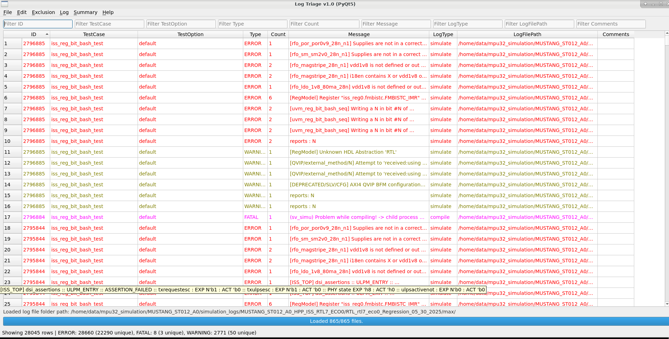
Why Log Triage Tool ?
This tool is designed to assist in triaging and analyzing simulation log files efficiently. It supports multi-user collaboration, exclusion management, and session persistence.

Slide 3
Features (some more fixes / features are coming in)
Load and parse simulation/compile log files
Filter, sort, and search log messages
Exclude messages and manage exclusion list
Export filtered data and summary to CSV
View summary of errors/warnings/fatal
Multi-column sorting and persistent settings

Slide 4
How to do
Just find the log_triage.py attached file attached from the mail.
Run the log_triage.py script using python in your vnc machine as below.
On LSF:
bsub -R "rUsage[RAM=10000]" python3 log_triage.py
On Local :
python3 log_triage.py

Slide 5
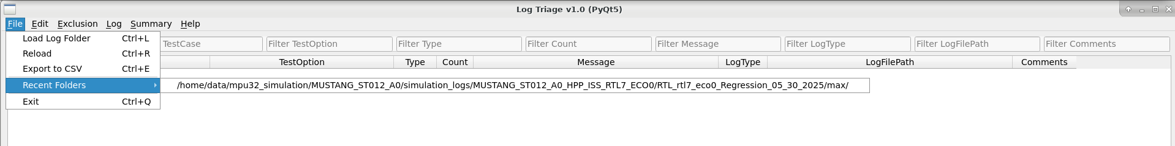
How to do (cont…)
Just Browse the any regression log folder, and wait for few seconds

Slide 6
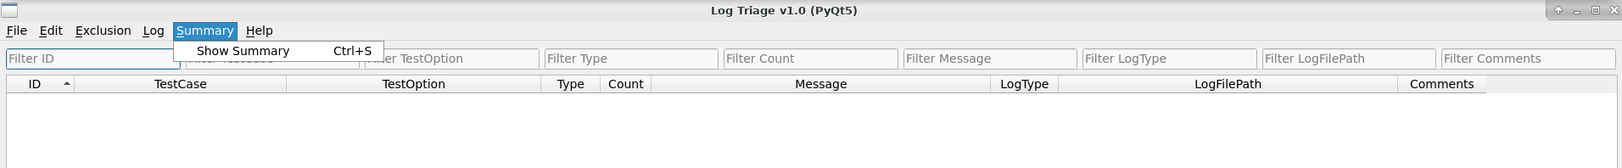
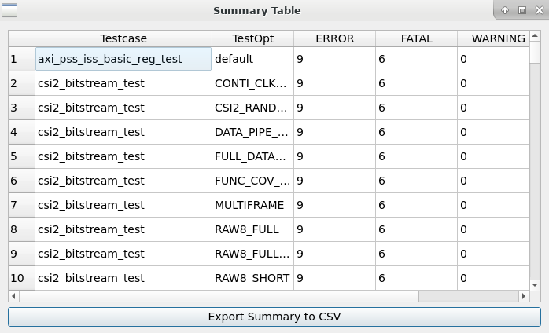
Explore
Just explore the all Menu options by yourself, it easy to use it.
Example:
Once you loaded the regression log folder, Just go to Summary, and click Show Summary.

Slide 7
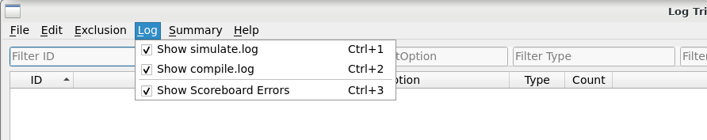
Preference
You can load both compile.log and simulate.log, or any one of them based on your preference.

Slide 8
Features (upcoming)
Exclusion
Redesign of the GUI for managing exclusions.
Enable reading and reapplying exclusion lists to the currently loaded log path.
Comments & Feedback
Support multi-user comments.
Ensure exported CSV files include the comments column.
Session Persistence (DB)
When a log folder is opened and updated (comments, exclusions), save all details in a .txt format.
Allow other users to load the .txt file to view previously stored information without reloading the log folder.

Slide 9
Thank You

Slide 10
Feedback and Suggestions
• Please explore the Log Triage tool and share your feedback.
• Suggestions for improvements or new features are welcome.
• Reach out for any queries or collaboration ideas.

